Slide 1
PL/SQL

Slide 2
INTRODUCTION
PL/SQL stands for procedural language/structured query language
It is an extension of the SQL language
It is the superset of structured query language
With the use of SQL user can only manipulate the information stored in the database
PL/SQL extends SQL by adding control structures found in other procedural languages.

Slide 3
Features of PL/SQL
PL/SQL allows sending an entire block of statements to the database at one time.
This reduces network traffic and provides high performance for the applications.
Applications written in PL/SQL are fully portable.
PL/SQL provides access to predefined SQL packages.
PL/SQL provides support for Object-Oriented Programming.
PL/SQL provides support for Developing Web Applications and Server Pages.

Slide 4
Architecture of pl/sql
Pl/sql engine executes pl/sql blocks.
Pl/sql engine executes only the procedural statements and send the sql statements to sql statement executor in the oracle server
Pl/sql engine resides in the oracle server
The call to the oracle engine needs to be made only once to execute any number of sql statements
Since the oracle engine is called only one for each block, resulting increased speed of processing as compared to call for each sql sentence.

Slide 5
Structure of PL/SQL Language
Consist of following sections
Declare(optional)
Used to declare variables and constants
Is an optional section
Begin(required)
It is the executable section containing the code which is executed when block is run
Exception(optional)
Handles exceptions occurring during processing
Is an optional section.
End;(required)

Slide 6
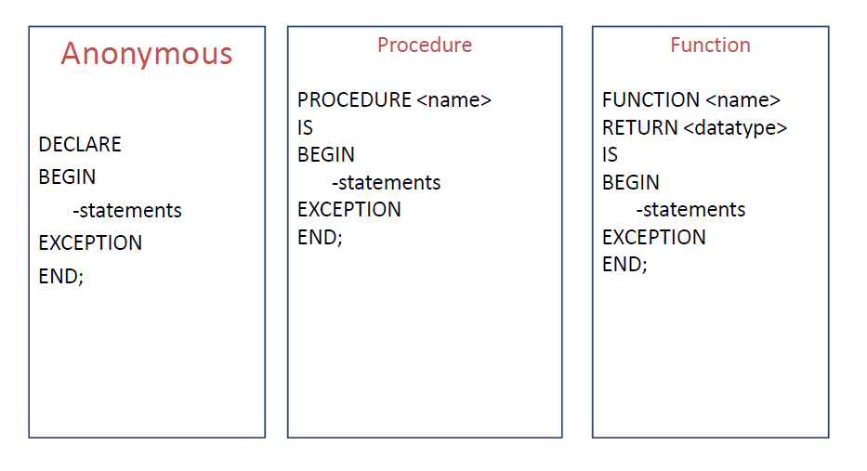
PL/SQL block types

Slide 7
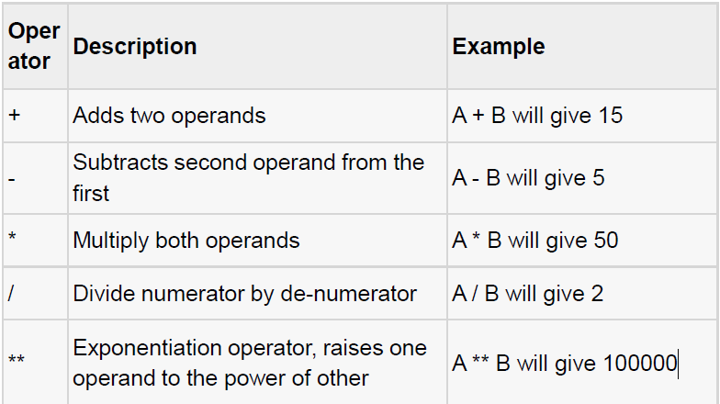
PL/SQL operators

Slide 8
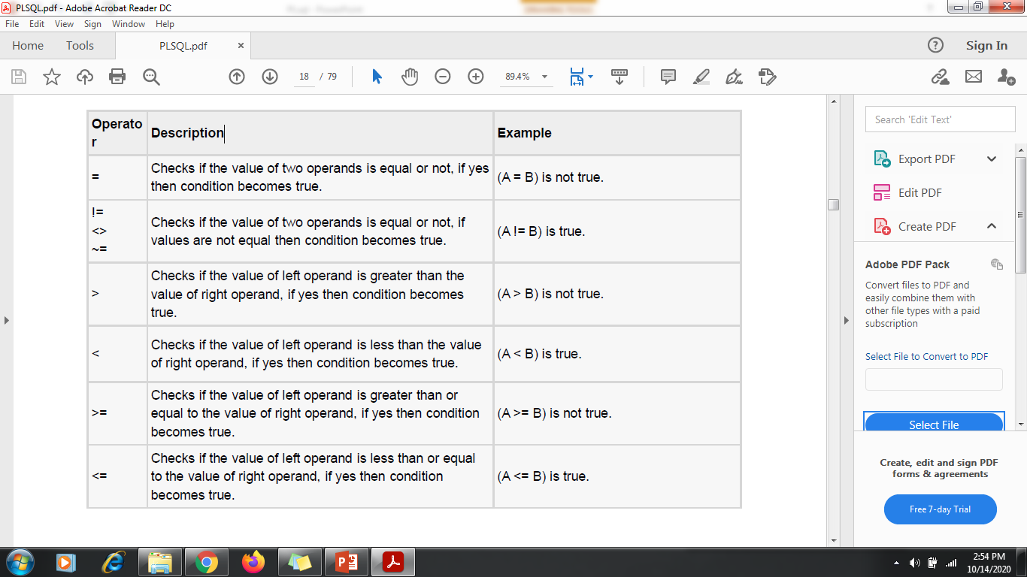
Relational operators

Slide 9
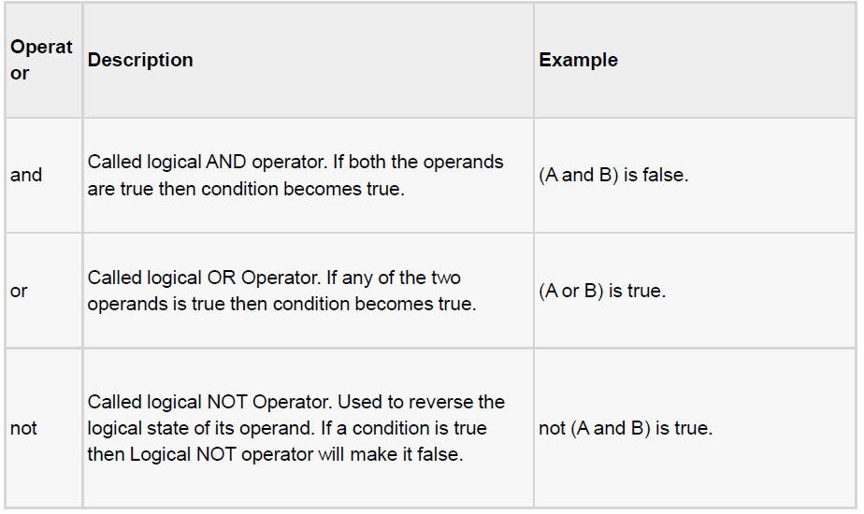
Logical operators

Slide 10
Data types
Scaler – Single values with no internal component, such as NUMBER, DATE, or BOOLEAN.
Large Object(LOB)- Pointers to large objects that are stored separately from other items, such as text, graphics, images, video clips and sound waves.
Composite- Data type that have internal components that can be accessed individually. For example, collections and records.
References- Pointer to other data types.

Slide 11
Scaler Datatypes
Numeric
Character
Boolean
Datetime

Slide 12
The PL/SQL Identifiers
PL/SQL identifiers are constants, variables, exceptions, procedures, cursors, and reserved words.
The identifiers consist of a letter optionally followed by more letters, numerals, dollar signs, underscores, and number signs and should not exceed 30 characters.
By default, identifiers are not case-sensitive. So you can use integer or INTEGER to represent a numeric value.
You cannot use a reserved keyword as an identifier eg.
BEGIN, BETWEEN, BY, DECLARE, DEFAULT, DESC, DISTINCT, DROP

Slide 13
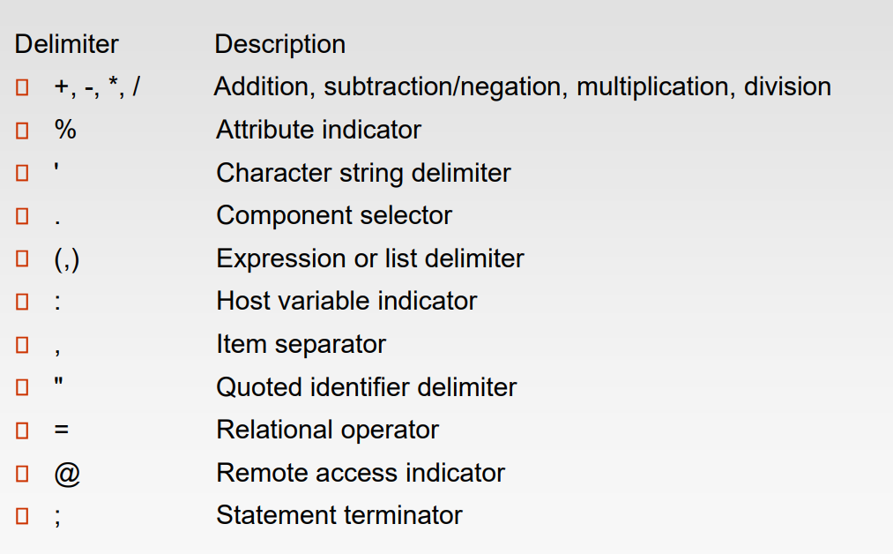
PL/SQL Delimiters
A delimiter is a symbol with a special meaning. Following is the list of delimiters in PL/SQL −

Slide 14
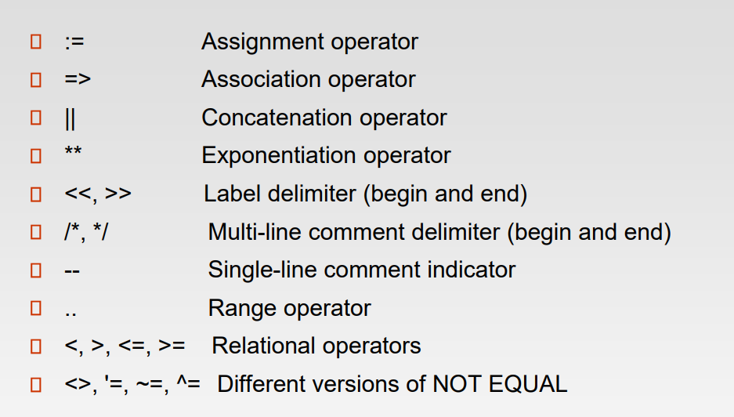

Slide 15
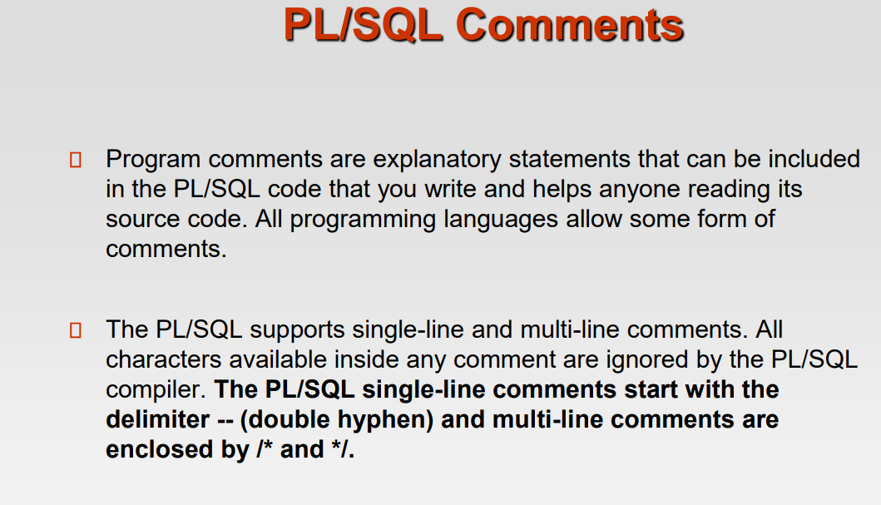

Slide 16
Variable Declaration
DECLARE
a number := 10;
b number := 20;
c number;
Declaring a Constant
A constant holds a value used in a PL/SQL block that does not change throughout the program. It is a user-defined literal value.
constant_name CONSTANT datatype := VALUE;
PI CONSTANT NUMBER := 3.141592654;

Slide 17
Example Program
DECLARE
message varchar2(30):= ‘Hello World’;
BEGIN
dbms_output.put_line(message);
END;

Slide 18
Read a value during runtime
Num:= :num;
This will produce a message on screen
Enter the value of NUM:
User can enter any value at run time to NUM.

Slide 19
Example-
Declare
a number(2);
b number (2);
c number(2);
Begin
a:= :a;
b:= :b;
c:= a+b;
dbms_output.put_line(‘sum of a & b = ‘ || c);
End;

Slide 20
DECLARE
-- constant declaration
pi constant number := 3.141592654;
-- other declarations
radius number(5,2);
dia number(5,2);
circumference number(7, 2);
area number (10, 2);
BEGIN
-- processing
radius := 10.5;
dia := radius * 2;
circumference := 2.0 * pi * radius;
area := pi * radius * radius;
-- output
dbms_output.put_line('Radius: ' || radius);
dbms_output.put_line('Diameter: ' || dia);
dbms_output.put_line('Circumference: ' || circumference);
dbms_output.put_line('Area: ' || area);
END;

Slide 21
Select into
Used to fetch values from some existing tables.
Syntax-
Select column_name into variable_name from table_name where condition;
Example-
declare
name varchar(55);
begin
select Ename into name from emp where empno =7902;
dbms_output.put_line(name);
end;

Slide 22
% Type
The %TYPE attribute is used to declare variables according to the already declared variable or database column. It is used when you are declaring an individual variable, not a record.
The syntax for declaring a variable with %TYPE is:
<Var_name> <Table_name>.<Column_name>%TYPE;
Where <Column_name> is the column defined in the <Table_name> .

Slide 23
Assigning the datatype and size of attribute to the variable
declare
name emp. Ename%type;
begin
select Ename into name from emp where Empno =7902;
dbms_output.put_line(name);
end;

Slide 24
% Row Type
The %ROWTYPE attribute is used to declare a record type that represents a row in a table.
The record can store an entire row or some specific data selected from the table.
A column in a row and corresponding fields in a record have the same name and data types.
The syntax for declaring a variable with %ROWTYPE is:
<Var_name> <Table_name> %ROWTYPE;

Slide 25
Example
declare
Var emp %rowtype;
begin
select * into var from emp where Empno =7902;
dbms_output.put_line(Var.Ename||' ‘||Var.sal);
end;

Slide 26
PLSQL Literals
Literals is an explicit numeric, character, string or Boolean values which are not represented by identifiers i.e. TRUE, NULL, etc.
A literal is a value that is expressed by itself and are generally constant. For example, if your name is Alex, then for you Alex is a literal(the value which is constant).
In other words, the value that is declared as a constant in a program is said to be literal
Note: PL/SQL literals are case-sensitive.
Types of literals in PL/SQL:
1. Numeric Literals (765, 23.56 etc.).
2. Character Literals (‘A’ ‘%’ ‘9’ ‘ ‘ ‘z’ etc.).
3. String Literals (tutorialspointexamples.com etc.).
4. BOOLEAN Literals (TRUE, FALSE and NULL).
5. Date and Time Literals (‘2016-12-25’ ‘2016-02-03 12:10:01’ etc.

Slide 27
Control statements
Conditional / selection
Iterative

Slide 28
Conditional / selection
IF condition then
Sequence of statements;
Else
Sequence of statements;
End if;

Slide 29
Example-
Declare
Num1 number;
Num2 number;
begin
Num1:= :Num1;
Num2:= :Num2;
if (Num1>Num2)
then
dbms_output.put_line('Num1 is greater :='||Num1);
else
dbms_output.put_line('Num2 is greater :='|| Num2);
end if;
end;

Slide 30
Example
declare
a number;
b number;
begin
a:=20;
b:=30;
if (a>b)
then
dbms_output.put_line ('a is greater’);
else
dbms_output.put_line ('b is greater’);
end if;
end;

Slide 31
IF –then else if
declare
num1 number:= 10;
num2 number:= 20;
begin
if (num1 < num2) then
dbms_output.put_line('num1 is small');
ELSEIF (num1 = num2) then
dbms_output.put_line('both are equal');
ELSE
dbms_output.put_line('num2 is greater');
end if;
dbms_output.put_line('End of Program');
end;

Slide 32
Nested If Else
Syntax
IF( boolean_expression 1)
THEN
-- executes when the boolean expression 1 is true IF(boolean_expression 2)
THEN
-- executes
when the boolean expression 2 is true sequence-of-statements;
END IF;
ELSE
-- executes
when the boolean expression 1 is not true else-statements;
END IF;

Slide 33
DECLARE
a NUMBER :=10;
b NUMBER :=15;
c NUMBER :=20;
BEGIN
dbms_output.put_line('Program started.' );
IF( a > b)THEN
/*Nested-if l */
dbms_output.put_line('Checking Nested-IF 1');
IF( a > c ) THEN
dbms_output.put_line('A is greatest');
ELSE
dbms_output.put_line('C is greatest');
END IF;
ELSE
/*Nested-if2 */
dbms_output.put_line('Checking Nested-IF 2' );
IF( b > c ) THEN
dbms_output.put_line('B is greatest' );
ELSE
dbms_output.put_line('C is greatest' );
END IF;
END IF;
End;

Slide 34
Iterative
Loop
While – loop
For-loop

Slide 35
Syntax
Loop
Sequence of statements;
Exit when condition;
End loop;

Slide 36
Loop Example-
Declare
i number(2);
Begin
i:=1;
Loop
Dbms_output.put_line(i);
i:=i+1;
Exit when i>10;
End loop;
End;

Slide 37
Example using While loop
declare
a number;
b number;
begin
a:=0;
b:=:b;
while a<b
loop
a:=a+1;
dbms_output.put_line(a);
end loop;
end;

Slide 38
While Loop Example-
Declare
A number(2);
Begin
A:=1;
While a<=10
Loop
Dbms_output.put_line(a*a);
A:=a+1;
End loop;
End;

Slide 39
Example using for loop
declare
a number(2);
begin
for a in 0..10
loop
dbms_output.put_line(a);
end loop;
end;

Slide 40
For loop Example-
declare
Total number;
i number;
begin
for i in 1..10
loop
Total:= 2*i;
dbms_output.put_line('2*'||i||':='|| Total);
end loop;
end;

Slide 41
GOTO Statement
A GOTO statement in PL/SQL programming language provides an unconditional jump from the GOTO to a labeled statement in the same subprogram.
The syntax for a GOTO statement in PL/SQL is as follows −
GOTO Label
..
..
<<Label>>
Statement

Slide 42
Go To Example-
Declare
Num1 number(2);
Num2 number(2);
Begin
Num1:=:num1;
Num2:=:num2;
If num1> num2 then
Goto p1;
Else
Goto p2;
End if;
<<p1>>
Dbms_output.put_line(‘num1 is bigger’);
Goto p3;
<<p2>>
Dbms_output.put_line(‘num2 is bigger’);
<<p3>>
Dbms_output.put_line(‘End of Program ‘);
End;

Slide 43
Case Statement
Like the IF statement, the CASE statement selects one sequence of statements to execute.
However, to select the sequence, the CASE statement uses a selector rather than multiple Boolean expressions.
A selector is an expression, the value of which is used to select one of several alternatives.

Slide 44
Syntax
Case Selector
When ‘Value1’ then S1;
When ‘Value2’ then S2;
When ‘Value3’ then S3;
When ‘Value4’ then S4;
…….
Else Sn; Default Case
End Case;

Slide 45
DECLARE
grade char(1) ;
BEGIN
grade := :grade;
CASE grade
when 'A’
then
dbms_output.put_line('Excellent');
when 'B’
then dbms_output.put_line('Very good');
when ‘C
then
dbms_output.put_line('Well done');
when 'D’
Then
dbms_output.put_line('You passed');
when 'F’
then
dbms_output.put_line('Better try again');
else
dbms_output.put_line('No such grade');
END CASE;
END;

Slide 46
Subprograms
Subprograms allow decomposition of a program into logical units.
Subprograms are named pl/sql blocks that can accept parameters and can be invoked are called as subprograms.
It is used to develop user defined functions and procedures.

Slide 47
They can be further classified as:
Local Subprograms
Stored Subprograms

Slide 48
Local Subprogram
Local Subprogram is local to the PL/SQL module, which contain it.
It can be created in the declarative section of PL/SQL module.
It can only be invoked in PLSQL block in which it is created.

Slide 49
Stored Subprogram
It is named PLSQL block that has been compiled and stored in oracle database.
It is stored as database object in database as tables are stored.
They are invoked or called by any the PL/SQL block.

Slide 50
Types of Subprograms
Two types
Procedure
Function

Slide 51
Procedure Vs Function
A procedure or a function is a group of sql and pl/sql statements that is used to perform a specific task.
A procedure is used to perform an action whereas a function is used to compute a value.
A procedure may return no value whereas a function must return a value.

Slide 52
Why do we use subprograms?
Modularity: It allows a programmer to divide a program into more than one well defined units called modules.
Reusability: it enables a subprogram to be used in any number of applications.

Slide 53
Creating a Procedure
A procedure is created with the CREATE OR REPLACE PROCEDURE statement.
The simplified syntax for the CREATE OR REPLACE PROCEDURE statement is as follows −
CREATE [OR REPLACE] PROCEDURE procedure_name [(parameter_name [IN | OUT | IN OUT] type [, ...])]
{IS | AS}
BEGIN < procedure_body >
END procedure_name;

Slide 54
➢ Where procedure-name specifies the name of the procedure.
➢ [OR REPLACE] option allows the modification of an existing procedure.
➢ The optional parameter list contains name, mode and types of the parameters.
➢ procedure-body contains the executable part.
➢ The AS keyword is used instead of the IS keyword for creating a standalone procedure

Slide 55
Parameter Modes
IN: This a default mode.
It is read only parameter
It represents the value that will be passed from outside
OUT:
OUT represents the parameter that will be used to return a value outside of the procedure.
It Return a value to the calling program.
IN OUT:
Passes an initial value to subprogram and return an updated value to the caller.

Slide 56
The following example creates a simple procedure that displays the string 'Hello World!' on the screen when executed.
CREATE OR REPLACE PROCEDURE greetings
AS
BEGIN
dbms_output.put_line('Hello World!’);
END; /
When the above code is executed using the SQL prompt, it will produce the following result − Procedure created

Slide 57
A standalone procedure is a procedure (a subprogram that performs a specific action) that is stored in the database.
Note: A standalone procedure that you create with the CREATE PROCEDURE statement differs from a procedure that you declare and define in a PL/SQL block or package.

Slide 58
Executing a Standalone Procedure
A standalone procedure can be called in two ways −
Using the EXECUTE keyword
Calling the name of the procedure from a PL/SQL block
The above procedure named 'greetings' can be called with the EXECUTE keyword as −
EXECUTE greetings;
The above call will display −
Hello World
PL/SQL procedure successfully completed.

Slide 59
The procedure can also be called from another PL/SQL block −
BEGIN
greetings;
END;
/
The above call will display −
Hello World
PL/SQL procedure successfully completed.

Slide 60
Deleting a Standalone Procedure
A standalone procedure is deleted with the DROP PROCEDURE statement.
Syntax for deleting a procedure is − DROP PROCEDURE procedure-name;
You can drop the greetings procedure by using the following statement −
DROP PROCEDURE greetings;

Slide 61
Procedure
Declare
Global variables declaration;
Procedure procedure name
(Arguments IN/OUT/IN OUT data types)
IS/AS
Variable and constant declaration;
Begin
PL/SQL statements;
Exception
Statements;
End procedure name;
Begin
Executable statements;
Procedure calling;
End;

Slide 62
Procedure- example
Declare
a number(2);
b number(2);
c number(4);
procedure multiplication (X in number, Y in number, Z out number)
is
begin
Z:=X*Y;
end multiplication;
begin
a:= :a;
b:= :b;
multiplication(a,b,c);
dbms_output.put_line(‘Multipication of a and b is:’||c);
end;

Slide 63
declare
a number;
procedure SquareNum (x in out number)
is
begin
x:=x*x;
End SquareNum;
begin
a:=5;
SquareNum(a);
dbms_output.put_line(‘Square of a is:’ ||a);
end;

Slide 64
DECLARE
a number;
b number;
c number;
PROCEDURE findMin(x IN number, y IN number, z OUT number) IS
BEGIN
IF x < y THEN
z:= x;
ELSE
z:= y;
END IF;
END findmin;
BEGIN
a:= 23;
b:= 45;
findMin(a, b, c);
dbms_output.put_line(' Minimum of (23, 45) : ' || c);
END;

Slide 65
Actual parameters can be passed in three ways −
Positional notation
Named notation
Mixed notation
Positional Notation In positional notation, you can call the procedure as − findMin(a, b, c, d);
In positional notation, the first actual parameter is substituted for the first formal parameter; the second actual parameter is substituted for the second formal parameter, and so on. So, a is substituted for x, b is substituted for y, c is substituted for z and d is substituted for m.
Named Notation In named notation, the actual parameter is associated with the formal parameter using the arrow symbol ( => ). The procedure call will be like the following − findMin(x => a, y => b, z => c, m => d);
Mixed Notation In mixed notation, you can mix both notations in procedure call; however, the positional notation should precede the named notation

Slide 66
Stored procedure
A procedure that has been compiled and stored in any of the oracle engine’s system table.

Slide 67
Stored procedure- Example
create or replace procedure addition(num1 in number, num2 in number, sum1 out number)
is
begin
sum1:=num1+num2;
end;

Slide 68
declare
a number(4);
b number(4);
c number(4);
begin
a:=:a;
b:=:b;
addition(a,b,c);
dbms_output.put_line(c);
end;

Slide 69
Creating a Function
A standalone function is created using the CREATE FUNCTION statement.
The simplified syntax for the CREATE OR REPLACE PROCEDURE statement is as follows −
CREATE [OR REPLACE] FUNCTION function_name [(parameter_name [IN | OUT | IN OUT] type [, ...])] RETURN return_datatype
{IS | AS}
BEGIN < function_body >
END [function_name];

Slide 70
Where, function-name specifies the name of the function.
[OR REPLACE] option allows the modification of an existing function.
The optional parameter list contains name, mode and types of the parameters.
IN represents the value that will be passed from outside and OUT represents the parameter that will be used to return a value outside of the procedure.
The function must contain a return statement.
The RETURN clause specifies the data type you are going to return from the function.
function-body contains the executable part.
The AS keyword is used instead of the IS keyword for creating a standalone function

Slide 71
Example of standalone function
CREATE OR REPLACE FUNCTION totalemployees RETURN number
IS
total number(2) := 0;
BEGIN
SELECT count(*) into total FROM emp;
RETURN total;
END;

Slide 72
Calling a Function
While creating a function, you give a definition of what the function has to do. To use a function, you will have to call that function to perform the defined task. When a program calls a function, the program control is transferred to the called function.
A called function performs the defined task and when its return statement is executed or when the last end statement is reached, it returns the program control back to the main program.
To call a function, you simply need to pass the required parameters along with the function name and if the function returns a value, then you can store the returned value.

Slide 73
Following program calls the function totalemployees from an anonymous block −
DECLARE
c number(2);
BEGIN
c := totalemployees();
dbms_output.put_line('Total no. of Employees: ' || c); END;

Slide 74
Function
Declare
Global variables declaration;
Function Function name
(Arguments IN data types…….)
Return data type
IS/AS
Variable and constant declaration;
Begin
PL/SQL statements;
Exception
Statements;
End function name;
Begin
Executable statements;
Function calling;
End;

Slide 75
Function-Example
Declare
Num1 number(2);
Num2 number(2);
Mul number(4);
Function multiplication(num1 in number, num2 in number)
Return number
is
mul number;
Begin
Mul:=num1 * num2;
Return(mul);
End multiplication;
Begin
Num1:=:num1;
Num2:=:num2;
Mul:=multiplication(num1, num2);
Dbms_output.put_line(mul);
End;

Slide 76
DECLARE
a number;
b number;
c number;
FUNCTION findMax(x IN number, y IN number)
RETURN number
IS
z number;
BEGIN
IF x > y THEN
z:= x;
ELSE
Z:= y;
END IF;
RETURN z;
END;
BEGIN
a:= 23;
b:= 45;
c := findMax(a, b);
dbms_output.put_line(' Maximum of (23,45): ' || c);
END;

Slide 77
Create Function CALCULATION(a number, b number, op char)
return number
is
Begin
if op='+' then
return (a+b);
elseif op='-' then
return (a-b);
elseif op='*' then
return (a*b);
else
return (a/b);
endif;
end;

Slide 78
Select CALCULATION(10,20,'*') from dual;

Slide 79
Function-Example
Declare
Fact number(4);
N number(2);
Function factorial(n in number)
Return number
is
I number(2);
Begin
Fact:=1;
For I in 1..n
loop
Fact:=fact*I;
End loop;
Return(fact);
End factorial;
Begin
N:=:n;
Fact:=factorial(n);
Dbms_output.put_line(fact);
End;

Slide 80
DECLARE
num number;
factorial number;
FUNCTION calculateFact(x number)
RETURN number
IS
f number;
BEGIN
IF x = 0 THEN
f := 1;
ELSE
f := x * calculateFact(x-1);
END IF;
RETURN f;
END;
BEGIN
num:= 6;
factorial := calculateFact(num);
DBMS_OUTPUT.PUT_LINE(' Factorial '|| num || ' is ' || factorial);
END;

Slide 81
Creating a function
Create function square_areaa(Length IN number)
Return number
Is
Area number(5,3);
Begin
Area:=(length*length);
Return Area;
End;
/

Slide 82
Calling a function
Begin
Dbms_output.put_line('Area of square is:'||Square_areaa(4));
End;

Slide 83
Creating a function
Create function Circle_areaa(radius number)
Return number
Is
Area number(5,3);
Pi constant number(5,3):=3.14;
Begin
Area:=(pi*radius*radius);
Return Area;
End;
/

Slide 84
Calling a function
Begin
Dbms_output.put_line('Area of Circle is:'||Circle_areaa(4));
End;

Slide 85
EMP_NAME | EMP_NO | SALARY | MANAGER
BBB | 1000 | 25000 | AAA
XXX | 1001 | 10000 | BBB
YYY | 1002 | 10000 | BBB
ZZZ | 1003 | 7500 | BBB

Slide 86
Insert Data in Table
In PL/SQL, we can insert the data into any table using the SQL command INSERT INTO. This command will take the table name, table column and column values as the input and insert the value in the base table.
The INSERT command can also take the values directly from another table using ‘SELECT’ statement rather than giving the values for each column. Through ‘SELECT’ statement, we can insert as many rows as the base table contains.

Slide 87
Insert data into Table
BEGIN
INSERT INTO <table_name>(<column1 >,<column2>,...<column_n>)
VALUES(<valuel><value2>,...:<value_n>);
END;

Slide 88
Insert Data from another table
BEGIN
INSERT INTO <table_name>(<columnl>,<column2>,...,<column_n>)
SELECT <columnl>,<column2>,.. <column_n> FROM <table_name2>;
END;

Slide 89
BEGIN
INSERT INTO MANAGER (CODE, NAME, AGE)
values(11, 'Riken', 56);
END;
INSERT INTO MANAGER (CODE, NAME, AGE)
SELECT CODE, NAME, AGE
FROM EMPLOYEE
WHERE CODE = 1;
END;

Slide 90
Update in PLSQL
The UPDATE statement is used to modify the values in a table. It is also called a Data Manipulation Language. It uses the names of the table, column, and values as inputs and performs the modification of values on the table.
Syntax:
UPDATE <<table name>> SET <<col1>>=<<val1>>, <<col2>>=<<val2>>,… WHERE <<Condition>>;

Slide 91
Update Single Column of a row
Begin
UPDATE EMPLOYEE SET NAME = 'HENRY' WHERE CODE=1;
END;

Slide 92
Update Multiple Columns of a row
BEGIN
UPDATE EMPLOYEE SET NAME = 'COMO', AGE = 30 WHERE CODE=2;
END;

Slide 93
Update multiple rows
BEGIN
UPDATE EMPLOYEE SET AGE = AGE +1;
END;

Slide 94
PLSQL Delete Command
DELETE statement is used to remove an entire record from the table. It is also called a Data Manipulation Language.
Syntax:
DELETE FROM << table name >> WHERE << condition >>;

Slide 95
Deleting Single row from a table
BEGIN
DELETE FROM EMPLOYEE WHERE CODE=2;
END;

Slide 96
Delete multiple rows from a table
BEGIN
DELETE FROM MANAGERDETAIL WHERE CODE IN( &amp, gt, 0);
END;

Slide 97
Delete entire rows from a table
BEGIN
DELETE FROM VEHICLE;
END;

Slide 98
%TYPE
Provide the data type of a variable or column.
Example-
sal employee.salary%TYPE;

Slide 99
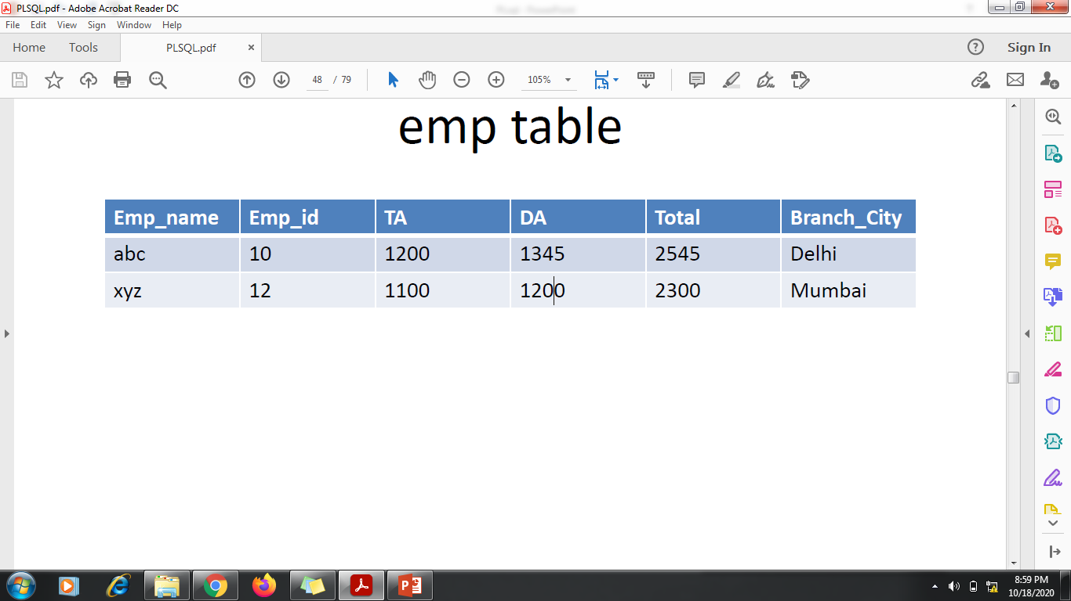

Slide 100
Example-
Declare
a emp1122.ta%TYPE;
b emp1122.da%TYPE;
t emp1122.total%TYPE;
Begin
Select ta,da into a,b from emp1122 where emp_id=12;
a:= a+100;
t:=a+b;
Update emp1122 set total =t where emp_id=12;
dbms_output.put_line(‘updated value of total is ’||t);
End;

Slide 101
%ROWTYPE
%ROWTYPE has all properties of %TYPE and one
additional that we required only one variable to access
any number of columns.
Example-
dept_rec dept%ROWTYPE; -- declaring record variable.
detp_rec.deptno;
dept_rec.deptname; -- accessing coloums

Slide 102
Declare
Record1 emp%ROWTYPE;
Begin
Select * into record1 from emp where empid=12;
Record1.total:=record1.ta+record1.da;
Update emp set total=record1.total where empid=12;
End;

Slide 103
Exceptions
Error conditions during a program execution.
It disturb the normal flow
Throw some error which will be captured by the exception log
Two Types:
System defined exceptions
User defined exceptions

Slide 104
System Defined Exceptions
No_data_found
Too_many_rows

Slide 105
Exception handling- example
declare
n emp.Ename%type;
begin
select Ename into n from emp where Sal = 4500;
dbms_output.put_line('empname :='||n);
exception
when too_many_rows then
dbms_output.put_line('more than one row returned');
end;

Slide 106
NO_DATA_FOUND: It is raised WHEN a SELECT INTO statement returns no rows. For eg:
DECLARE
temp varchar(20);
BEGIN
SELECT Ename into temp from emp where Ename='Aarif';
exception
WHEN no_data_found THEN
dbms_output.put_line('ERROR');
dbms_output.put_line('there is no name as');
dbms_output.put_line('Aarif in Emp table');
end;

Slide 107
User Defined Exception
Declare an exception
Raise an exception
Handle an exception

Slide 108
Exception handling- example
declare
a number;
b number;
c number;
e exception;
begin
a:=:a;
b:=:b;
if b=0 then
raise e;
end if;
c:=a/b;
dbms_output.put_line('result='||c);
exception when e then
dbms_output.put_line('error!- your divisor is zero');
end;

Slide 109
DECLARE
c_id customers1.id%type := :c_id;
c_name customerS1.Name%type;
c_addr customers1.address%type;
-- user defined exception
ex_invalid_id EXCEPTION;
BEGIN
IF c_id <= 0 THEN
RAISE ex_invalid_id;
ELSE
SELECT name, address INTO c_name, c_addr
FROM customers1
WHERE id = c_id;
DBMS_OUTPUT.PUT_LINE ('Name: '|| c_name);
DBMS_OUTPUT.PUT_LINE ('Address: ' || c_addr);
END IF;
EXCEPTION
WHEN ex_invalid_id THEN
dbms_output.put_line('ID must be greater than zero!');
WHEN no_data_found THEN
dbms_output.put_line('No such customer!');
WHEN others THEN
dbms_output.put_line('Error!');
END;

